Slide 1

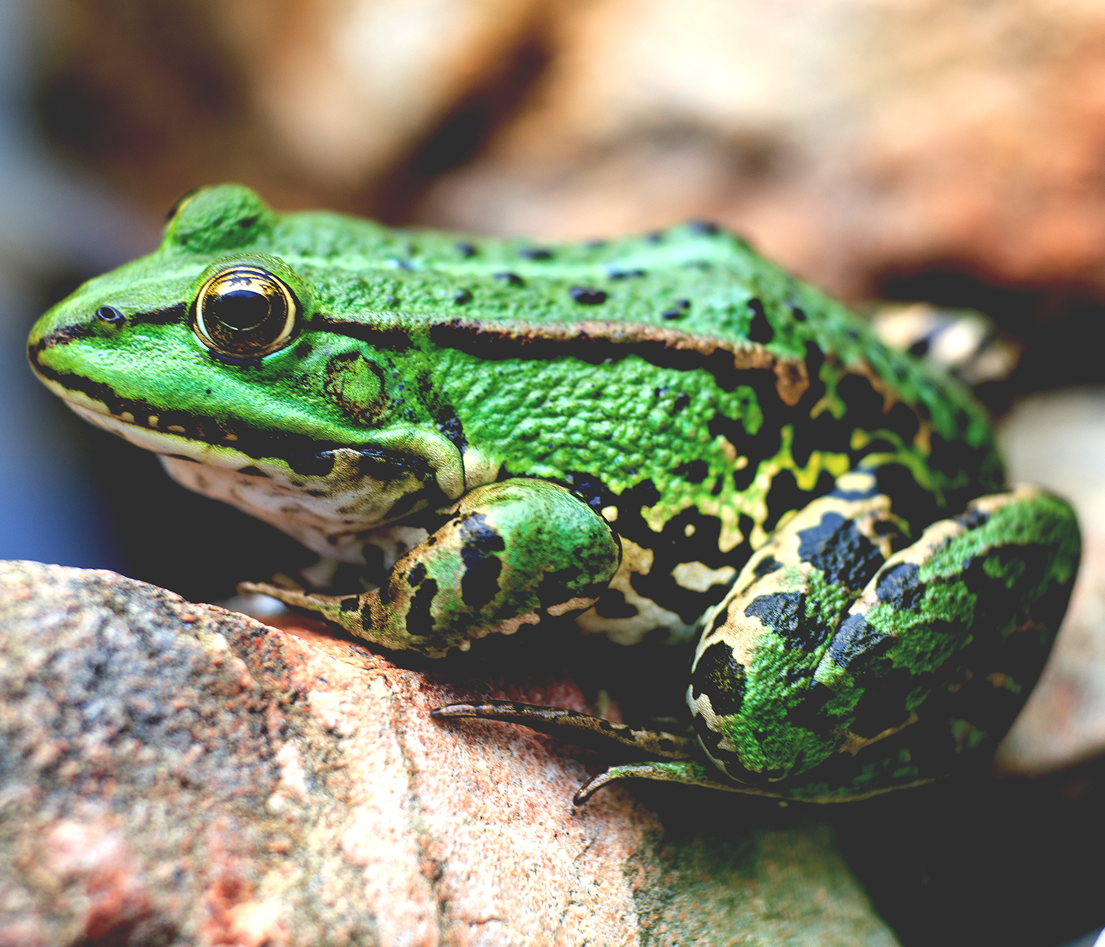
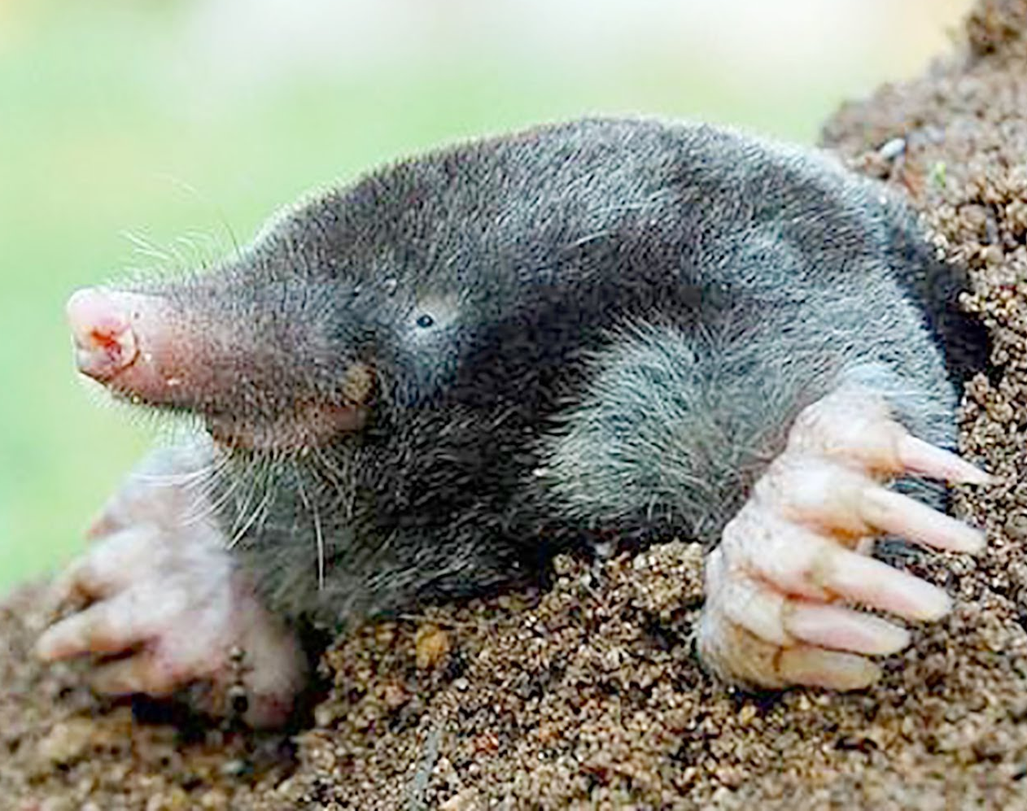
Reception Curriculum Evening

Slide 2
Talk 4 Writing
Notes:
Whole school approach.
Show a pre drawn sentence from the story map. Parents create actions and they retell with teachers.
Show Billy Goats Gruff completed story map.
Model how to use a story map to write a sentence. Imitate.
Then change an adjective – innovate.
Invent a new sentence – e.g. new setting

Slide 3
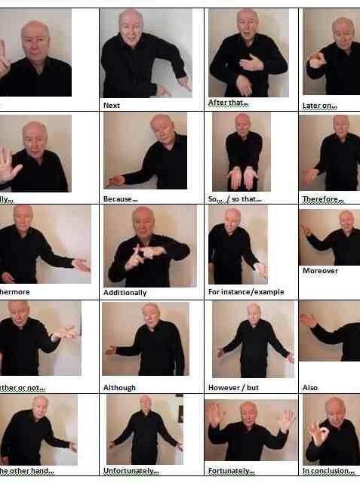
Hook and story
Story map
Talk4Writing actions
Role play and continuous provision
Links to writing
Foundations of story-telling
Rich descriptive vocabulary
Imitation, innovation, invention
Notes:
Whole school approach.
Show a pre drawn sentence from the story map. Parents create actions and they retell with teachers.
Show Billy Goats Gruff completed story map.
Model how to use a story map to write a sentence. Imitate.
Then change an adjective – innovate.
Invent a new sentence – e.g. new setting

Slide 4
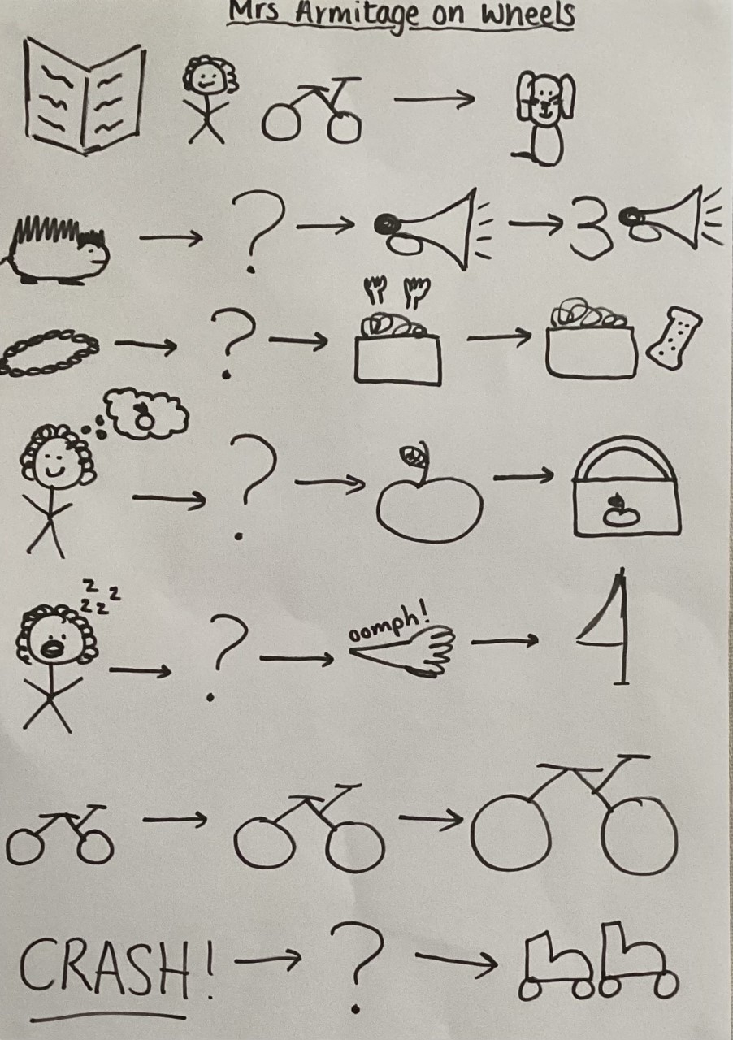
Story map
Notes:
Whole school approach.
Show a pre drawn sentence from the story map. Parents create actions and they retell with teachers.
Show Billy Goats Gruff completed story map.
Model how to use a story map to write a sentence. Imitate.
Then change an adjective – innovate.
Invent a new sentence – e.g. new setting

Slide 5
Fine Motor skills
Notes:
Whole school approach.
Show a pre drawn sentence from the story map. Parents create actions and they retell with teachers.
Show Billy Goats Gruff completed story map.
Model how to use a story map to write a sentence. Imitate.
Then change an adjective – innovate.
Invent a new sentence – e.g. new setting

Slide 6
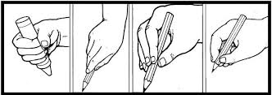
Notes:
Whole school approach.
Show a pre drawn sentence from the story map. Parents create actions and they retell with teachers.
Show Billy Goats Gruff completed story map.
Model how to use a story map to write a sentence. Imitate.
Then change an adjective – innovate.
Invent a new sentence – e.g. new setting

Slide 7
Handwriting practise:
Daily handwriting practise
Letter formation catch phrases
Writing at home
Notes:
Whole school approach.
Show a pre drawn sentence from the story map. Parents create actions and they retell with teachers.
Show Billy Goats Gruff completed story map.
Model how to use a story map to write a sentence. Imitate.
Then change an adjective – innovate.
Invent a new sentence – e.g. new setting

Slide 8
Fine motor activities
Notes:
Whole school approach.
Show a pre drawn sentence from the story map. Parents create actions and they retell with teachers.
Show Billy Goats Gruff completed story map.
Model how to use a story map to write a sentence. Imitate.
Then change an adjective – innovate.
Invent a new sentence – e.g. new setting

Slide 9
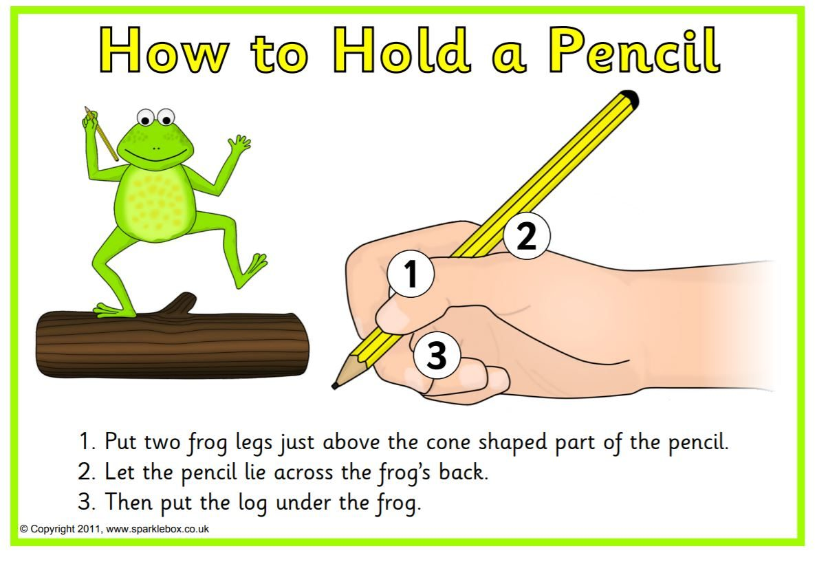
Dough Disco
Playdough
Tweezers and tongs, rolling – cooking
Threading – beads, string, buttons
Monkey bars, climbing.
Construction – Lego, building
Pegs –washing lines
Squeezing bottles/sponges
Elastic bands
Puzzles
Finger painting
Finger exercises
Reminders for correct pencil grip – frog on a log
Notes:
Whole school approach.
Show a pre drawn sentence from the story map. Parents create actions and they retell with teachers.
Show Billy Goats Gruff completed story map.
Model how to use a story map to write a sentence. Imitate.
Then change an adjective – innovate.
Invent a new sentence – e.g. new setting

Slide 10
Maths
Notes:
Subitising – what is it? Why is it important? How can you help at home?
Helper board – model how we use each section.
Tens Frame, part whole models, diennes, place value chart, number line
Number sentences – show is different ways.

Slide 11
Number
Notes:
Subitising – what is it? Why is it important? How can you help at home?
Helper board – model how we use each section.
Tens Frame, part whole models, diennes, place value chart, number line
Number sentences – show is different ways.

Slide 12
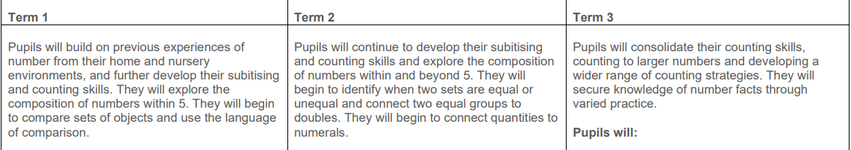
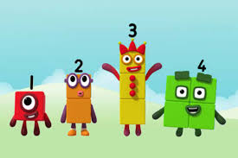

Notes:
Whole school approach.
Show a pre drawn sentence from the story map. Parents create actions and they retell with teachers.
Show Billy Goats Gruff completed story map.
Model how to use a story map to write a sentence. Imitate.
Then change an adjective – innovate.
Invent a new sentence – e.g. new setting

Slide 13
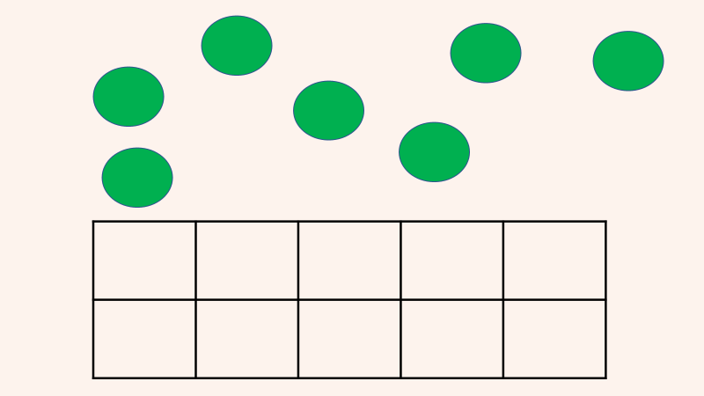

Slide 14
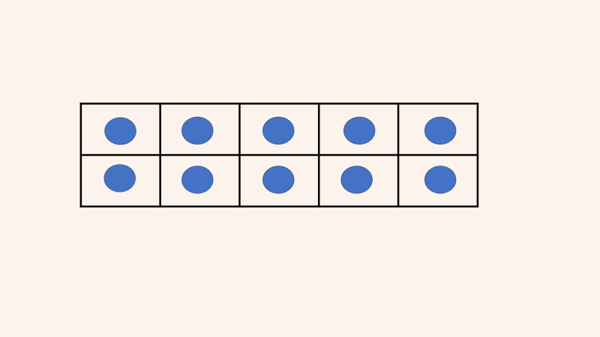

Slide 15
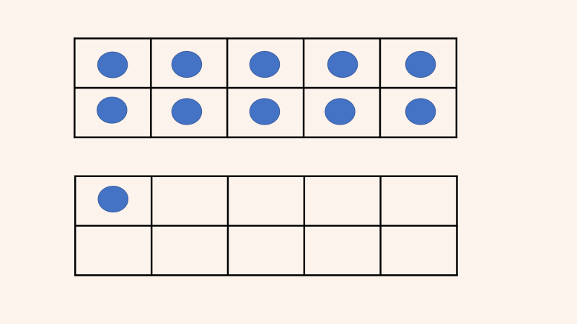

Slide 16
Use your hands
You can use your hands to visualise numbers. For example, five can be represented by five fingers on one hand, or three fingers on one hand and two fingers on the other.
Fantastic flashcards
Make some flashcards that show dot patterns, tally marks and fingers being held up (if you are feeling creative!). Can your child tell you how many there are without counting?
To make this harder, show them a flashcard for only a few seconds and then hide it! This encourages them to subitise rather than count.
Colourful counters
Throw a small number of counters in two different colours on a table and ask your child to say what they see.
For example, “I see three red counters and two yellow counters. There are five counters altogether”. You don’t have to use counters either — there are plenty of alternatives.
Notes:
Whole school approach.
Show a pre drawn sentence from the story map. Parents create actions and they retell with teachers.
Show Billy Goats Gruff completed story map.
Model how to use a story map to write a sentence. Imitate.
Then change an adjective – innovate.
Invent a new sentence – e.g. new setting

Slide 17
Pattern
Notes:
Little Wandle 90% fluency - why?
Why its important to return books on a Monday!
Decoding, Prosody and Comprehension.
Give out tricky words.

Slide 18
Pattern in nature
Repeating patterns
Spotting errors in patterns
Progression into number patterns e.g. timetables, doubles etc.
Notes:
Whole school approach.
Show a pre drawn sentence from the story map. Parents create actions and they retell with teachers.
Show Billy Goats Gruff completed story map.
Model how to use a story map to write a sentence. Imitate.
Then change an adjective – innovate.
Invent a new sentence – e.g. new setting

Slide 19
Reasoning
Notes:
Little Wandle 90% fluency - why?
Why its important to return books on a Monday!
Decoding, Prosody and Comprehension.
Give out tricky words.

Slide 20
Play and have a conversation with your child by asking them questions..
What would happen if I remove this item from the pattern?
What is next in the pattern?
What do you notice?
How do you know?
What can you see? How do you see it?
Tell me about what you're doing?
Why would it be.. (red, a stick etc.)?
I wonder what would happen if I did this?
Notes:
Whole school approach.
Show a pre drawn sentence from the story map. Parents create actions and they retell with teachers.
Show Billy Goats Gruff completed story map.
Model how to use a story map to write a sentence. Imitate.
Then change an adjective – innovate.
Invent a new sentence – e.g. new setting

Slide 21
Phonics
Notes:
Little Wandle 90% fluency - why?
Why its important to return books on a Monday!
Decoding, Prosody and Comprehension.
Give out tricky words.

Slide 22
-Little Wandle scheme - GPCS Phase 2 and 3 - blending / blending in their heads - Tricky words - Parent pages
Notes:
Little Wandle 90% fluency - why?
Why its important to return books on a Monday!
Decoding, Prosody and Comprehension.
Give out tricky words.

Slide 23
Reading

Slide 24
Little Wandle phonics scheme
Data and assessment
Phonics interventions
Flood Fill reading – decoding, prosody, comprehension
Wednesday book
Collins Hub
Decodable /Library book – Friday
Notes:
All get a Monday book, this is lower than the reading level and may be a re-read this is normal!! Plus they will get another weekly book which is one they have read in class. They will get this on Wednesday unless we have had a special day. Both books must be in book bags ready to return each Wednesday, or my class Thursday for lib session..Why its important to return books on a Wednesday. Other children will not get a book. This is why we have had to move to e-books and we do not want any more.
Please record in the reading records what they are reading and any problems. These will be checked weekly as part of reading sessions.
Little Wandle 90% fluency - why?.
Data and assessment – each haft term we complete phonic assessments to understand where the children are with their phonics, this data then tells us what books the children should be reading and what phonics inventions need to take place and which children need to be involved in these.
Flood fill reading – each child is read with 3 times a week as part of flood fill reading sessions, these sessions focus on decoding the words in the book, prosody – reading with expression and comprehension – asking questions to gage whether they have understood the text. On the last read of the week – thursday we will write in the children's reading records.
The children complete at least 2 adult led writing activities a week, this includes writing simple CVC words like cat.

Slide 25
RE
Each topic is taught through an RE day
Adult led activities themed around our big question for the topic.
Continuous provision activities linked to the big question.
We take pictures and evidence the children's answers in our whole class RE book.

Slide 26
Music
Music will be taught by rhyme time by class teachers.
Singing assembly weekly where children will be taught to sing as a whole school
The Christmas play will be taught by Miss Wilson using her musical theatre degree

Slide 27
Seesaw

Slide 28
Seesaw
Builds a record of a child's experiences, development and learning journey through their early years education.
Weekly round up of learning
Recording their weekly journey
Used as a tool to provide pictures and showing progress as well as folders

Slide 29


Free Workshop for Parents & Carers
Dates: 5th November – 3rd December (Attendance to all sessions is preferred)
Times: 9-11am
Over the five weeks, we’ll explore and exchange ideas on supporting children’s emotional well-being, their social interactions, and ways to assist them both academically and emotionally at home. This also offers a fantastic opportunity to connect with other parents from across the school on a weekly basis.
Please complete a referral form or discuss this opportunity with your Class Teacher
Please see the website calendar and emails for dates.

Slide 30
Website

Slide 31
What can you do to help?
Name writing
Reading books
Oral blending games
Maths games

Slide 32
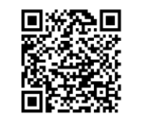
Questions?
Parental feedback

